Slide 1
5293 Final Project
Team 3

Slide 2
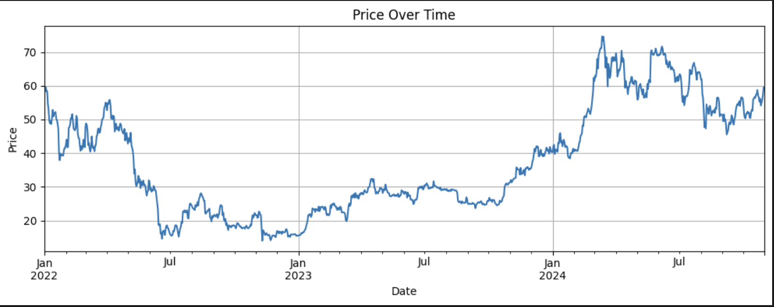
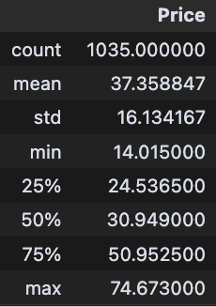
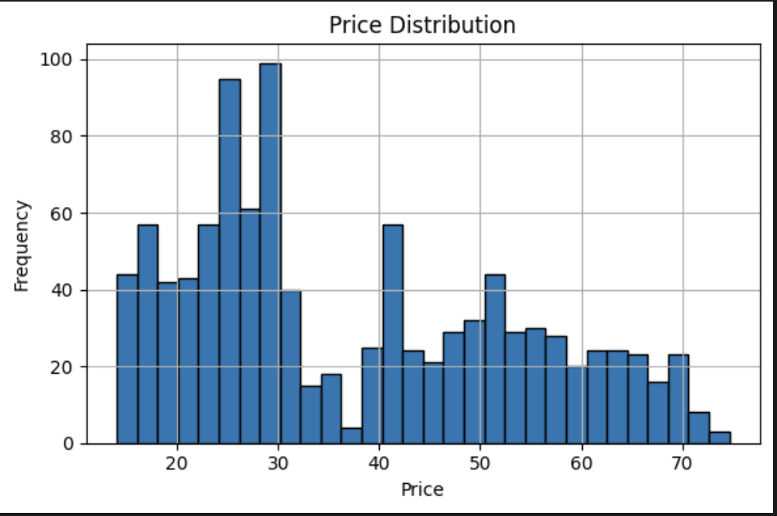
Data Overview & summary statistics
Timeframe: 1,035 daily records from Jan 2022 to Oct 2024
Target Variable: Next-day price prediction
Feature Set: Technical indicators (SMA, EMA, RSI, MACD, Bollinger Bands)
Mean price: 37.36, Std: 16.13
Min: 14.01, Max: 74.67
Right-skewed

Slide 3
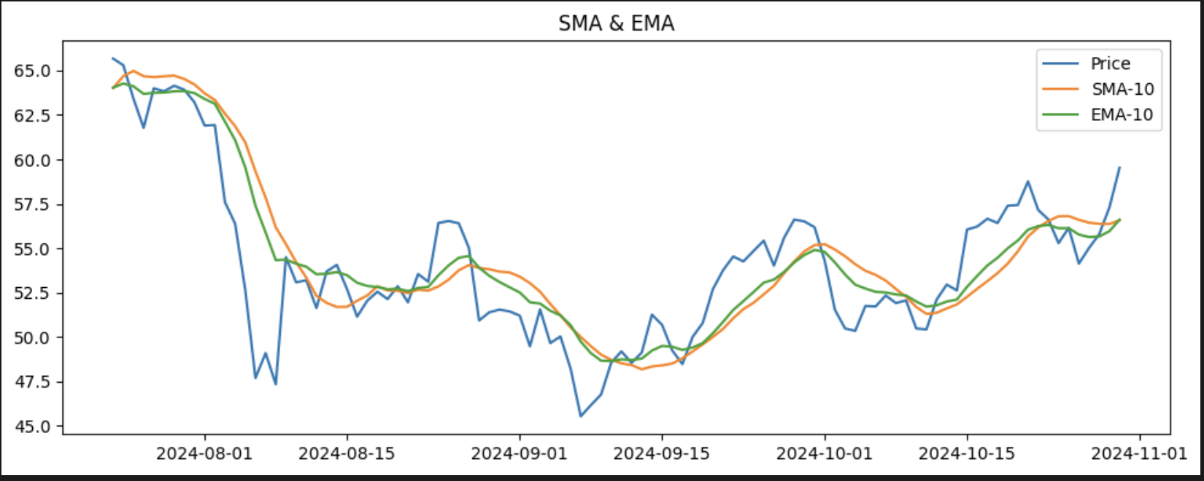
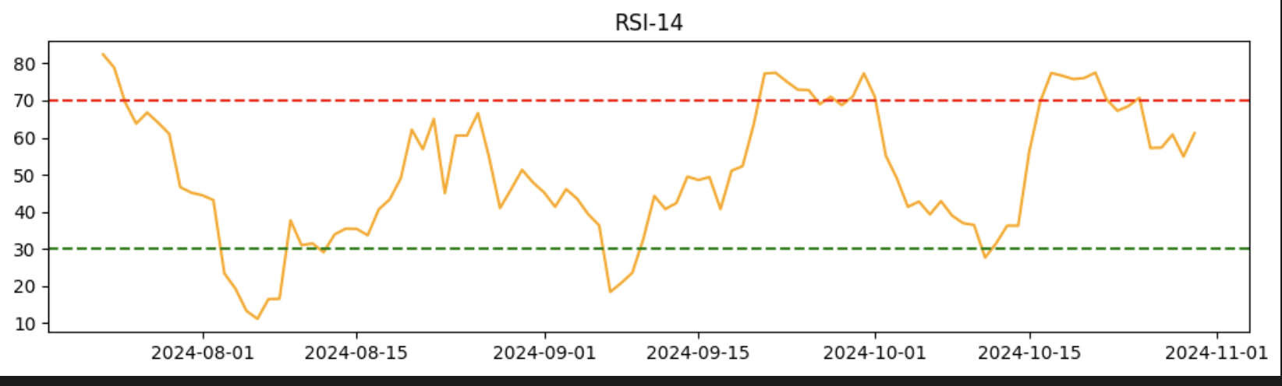
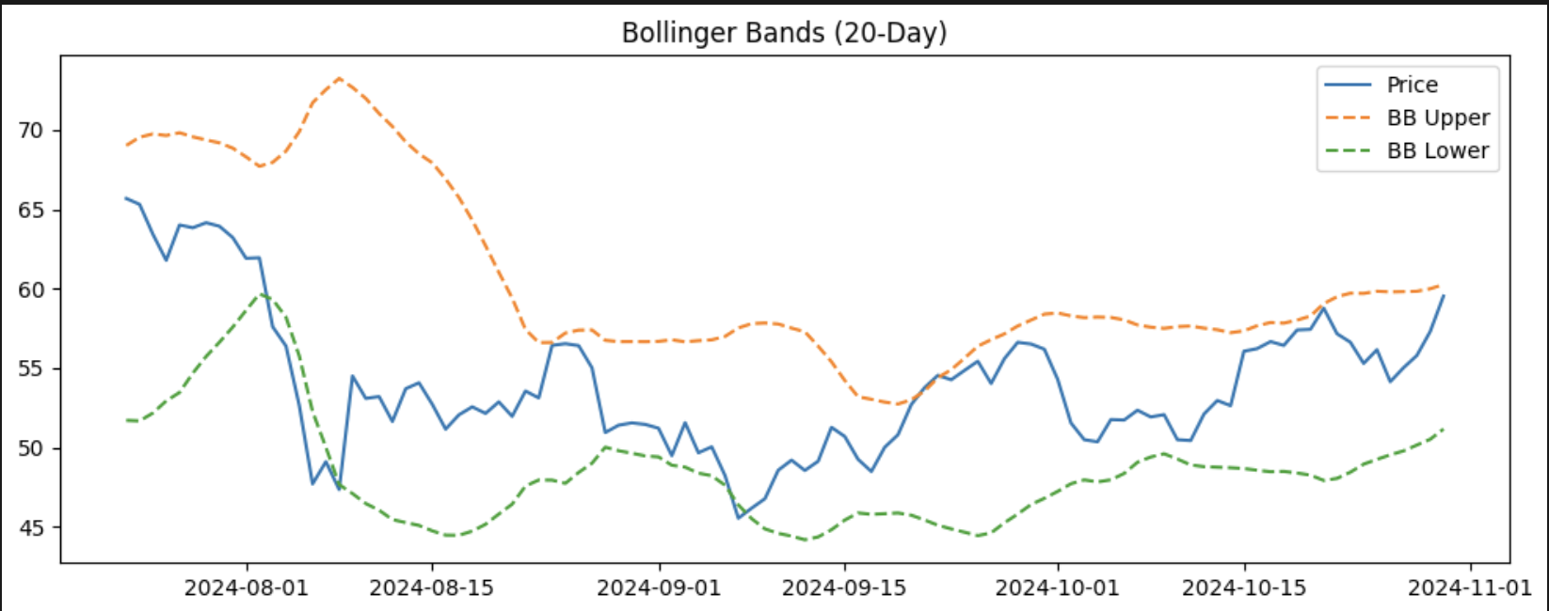
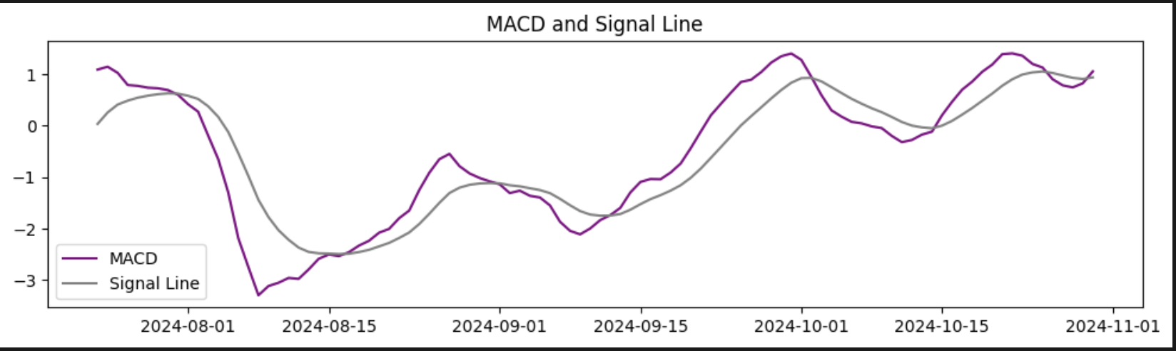
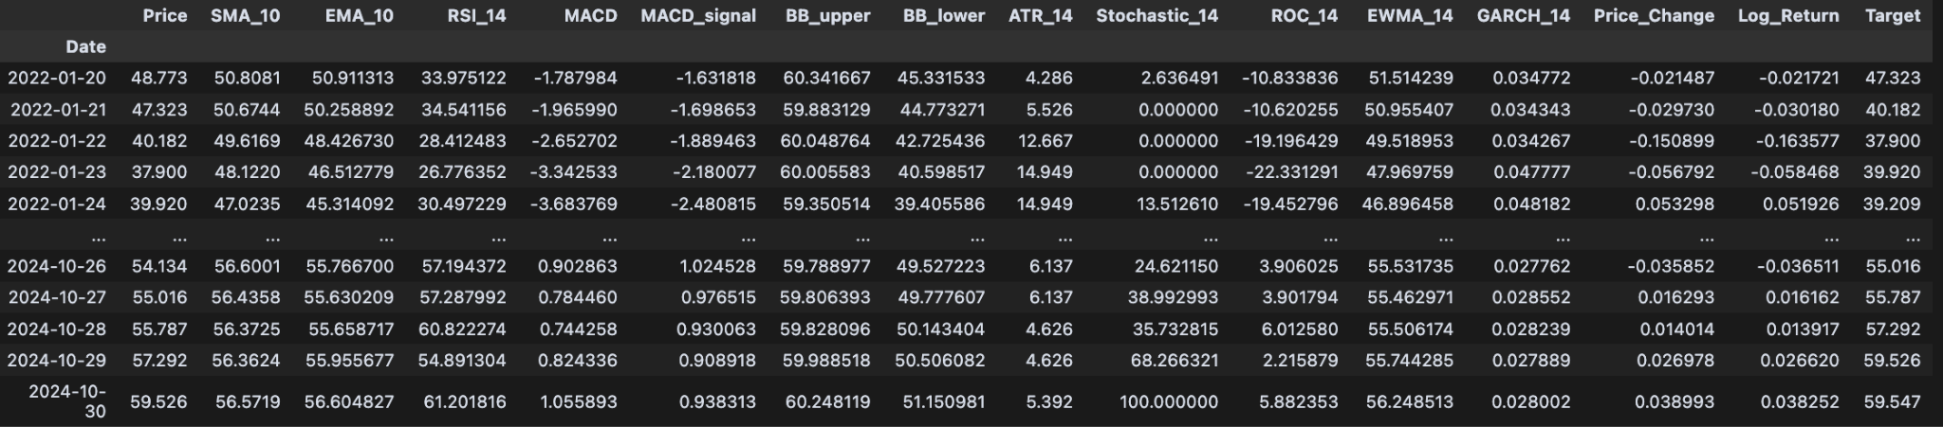
Technical Indicators

Slide 4
RF
Trained on rolling 5-day windows to predict next-day price
Hyperparameter:
n_estimators: 100
Max_depth: 5
Min_samples_split: 2
Min_samples_leaf: 1
Max_features: 'sqrt'
Evaluation Metrics:
MSE: 2.4962
RMSE: 1.5788
R²: 0.9905

Slide 5
SVM
Trained on rolling 5-day windows to predict next-day price
Hyperparameter:
C: 500
Epsilon: 0.5
Kernel: 'rbf'
Gamma: 'scale'
Shrinking: True
Evaluation Metrics:
MSE: 3.1327
RMSE: 1.7699
R²: 0.9880

Slide 6
GBM
Trained on rolling 5-day windows to predict next-day price
Hyperparameter:
N_estimators: 100
Learning_rate: 0.1
Max_depth: 3
Subsample: 0.9
Min_samples_split: 2
Max_features: 'sqrt'
Evaluation Metrics:
MSE 2.2822
RMSE: 1.5107
R²: 0.9913

Slide 7
XGB
Trained on rolling 5-day windows to predict next-day price
Hyperparameter:
N_estimators: 100
Learning_rate: 0.1
Max_depth: 3
Subsample: 0.9
Colsample_bytree: 0.8
Gamma: 0
Evaluation Metrics:
MSE: 2.6209
RMSE: 1.6189
R²: 0.99

Slide 8
MLP
Trained on rolling 5-day windows with scaled input features.
Hyperparameter:
Hidden_layer_sizes: (64, 64)
Activation: 'relu'
Solver: 'adam'
Learning_rate: 'adaptive'
Alpha: 0.0001
Max_iter: 500
Evaluation Metrics:
MSE: 7.0051
RMSE: 2.6467
R²: 0.9732

Slide 9
RNN
Trained on rolling 5-day windows with scaled input features.
Hyperparameter:
RNN Layer 1 Units: 64
RNN Layer 2 Units: 32
Dropout: 0.2
Optimizer: Adam
Loss Function: MSE
Batch Size: 16
Epochs: 50
Patience: 10
Evaluation Metrics:
MSE: 6.7375
RMSE: 2.5957
R²: 0.9742

Slide 10
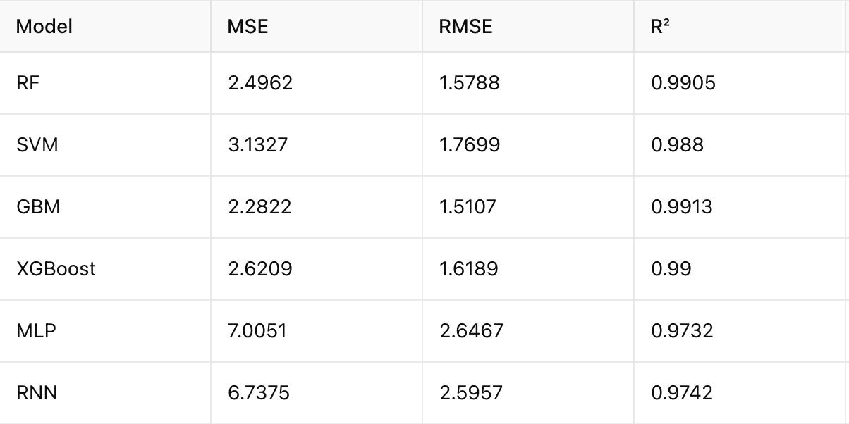
Model Performance

Slide 11
Trading logic
predicted price > current price
buy
If buy 5 times a row, then hold
predicted price < current price
sell
If sell 5 times a row, then hold

Slide 12
Task 1 without leverage
Strategy Logic:
Buy if predicted price > current price by 0.01%
Sell if predicted price < current price by 0.02 %
Hold otherwise
One unit traded per action
No action can repeat for more than 5 consecutive steps
Ensemble Method:
Simple Average of predictions from: RF, RNN, XGB, MLP

Slide 13
RF
Total Actions: 1142
Total Buys: 482
Total Sells: 521
Total Holds: 139
Final Portfolio Value: $15724.54
Cash: $10426.73
Crypto Units: 89
Accumulated Realized P&L: $985.08

Slide 14
XGB
Total Buys: 512
Total Sells: 493
Total Holds: 60
Final Portfolio Value: $16407.01
Cash: $9621.05
Crypto Units: 114
Accumulated Realized P&L: $1410.50

Slide 15
MLP
Total Buys: 643
Total Sells: 360
Total Holds: 88
Final Portfolio Value: $20536.64
Cash: $2559.79
Crypto Units: 302
Accumulated Realized P&L: $1338.86

Slide 16
RNN
Total Buys: 493
Total Sells: 508
Total Holds: 175
Final Portfolio Value: $16347.13
Cash: $10096.90
Crypto Units: 105
Accumulated Realized P&L: $1133.00

Slide 17
Ensemble
Total Actions: 1066
Total Buys: 596
Total Sells: 409
Total Holds: 61
Final Portfolio Value: $19929.64
Cash: $4988.62
Crypto Units: 251
Accumulated Realized P&L: $1903.01

Slide 18
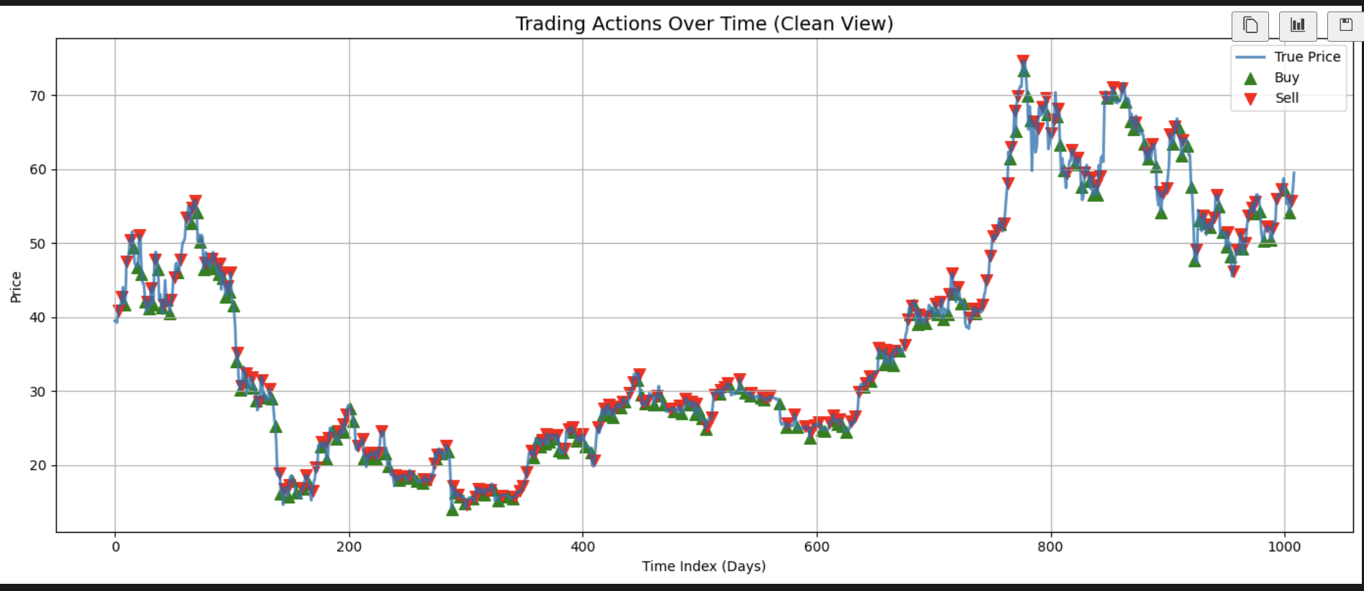
Task 1 without leverage

Slide 19
Task 2 with leverage
Strategy Logic:
Buy 1 if predicted price > current price by 0.01%
Buy 2 if > current price by 0.02%
Sell 1 if predicted price < current price by 0.02 %
Sell 2 if < current price by
Hold otherwise
One unit traded per action
No action can repeat for more than 5 consecutive steps
Ensemble Method:
Simple Average of predictions from: RF, RNN, XGB, MLP

Slide 20
RF
Total Actions: 2145
Total Buys: 964
Total Sells: 1044
Total Holds: 137
Final Portfolio Value: $15424.73
Cash: $10900.76
Crypto Units: 76
Accumulated Realized P&L: $1197.85

Slide 21
XGB
Total Actions: 2070
Total Buys: 1024
Total Sells: 987
Total Holds: 59
Final Portfolio Value: $16866.00
Cash: $9306.19
Crypto Units: 127
Accumulated Realized P&L: $2377.47

Slide 22
MLP
Total Actions: 2092
Total Buys: 1284
Total Sells: 722
Total Holds: 86
Final Portfolio Value: $24880.91
Cash: $356.19
Crypto Units: 412
Accumulated Realized P&L: $3437.80

Slide 23
RNN
Total Actions: 2176
Total Buys: 984
Total Sells: 1019
Total Holds: 173
Final Portfolio Value: $16704.42
Cash: $10394.66
Crypto Units: 106
Accumulated Realized P&L: $2068.33

Slide 24
Ensemble
Total Actions: 2069
Total Buys: 1190
Total Sells: 818
Total Holds: 61
Final Portfolio Value: $23756.70
Cash: $422.51
Crypto Units: 392
Accumulated Realized P&L: $4270.31

Slide 25
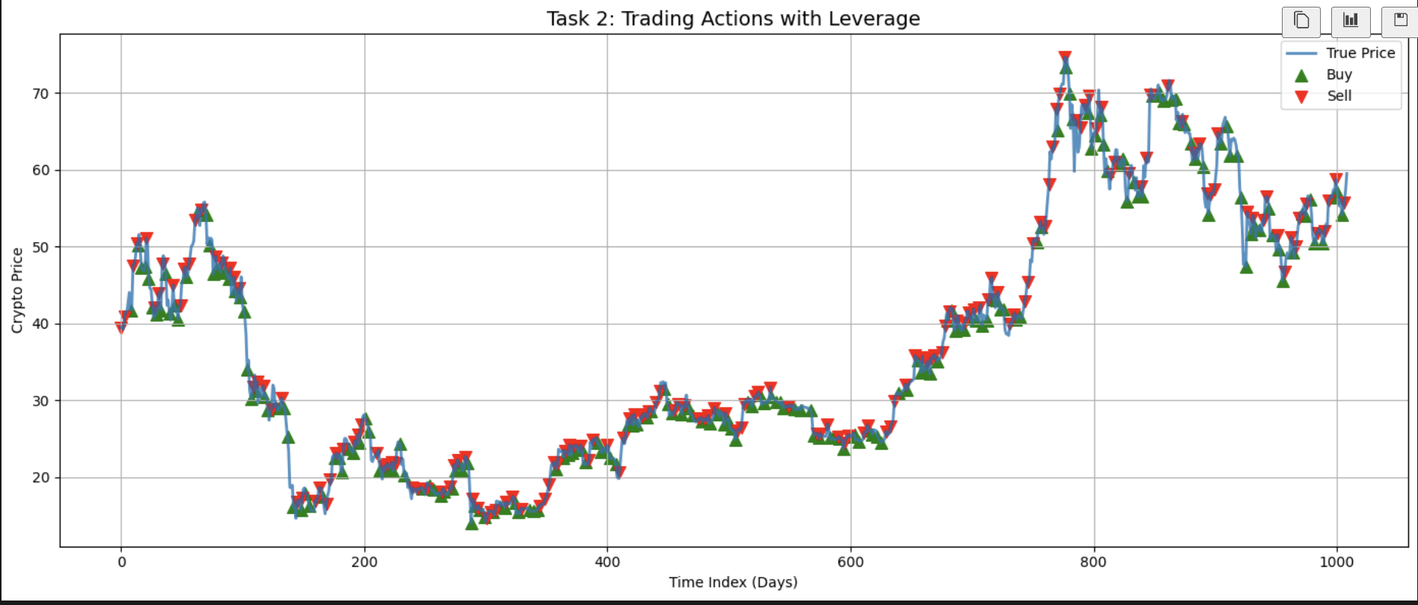
Task 2 with leverage

Slide 26
Thank You

